Slide 1
Graphics in C language
Lecture by Waseemullah
Lecturer
Department of CS&IT
NED University of Engineering and Technology, Karachi
osama ahmed CT 68
Notes:
Department of CS&IT, NED University of Engineering and Technology, Karachi
www.sirjameel.com

Slide 2
Text mode vs Graphics mode of C
Text Mode | Graphics Mode
Basic Unit is character | Basic Unit is pixel
80 columns, 50 rows | 640 columns, 480 rows
osama ahmed CT 68

Slide 3
My First program/drawing a line
#include<conio.h>
#include<graphics.h>
main()
{
int gd=DETECT, gm;
initgraph(&gd, &gm, “C:/TC/bgi”);
line(0,0,200,200);
getch();
closegraph();
}
osama ahmed CT 68

Slide 4
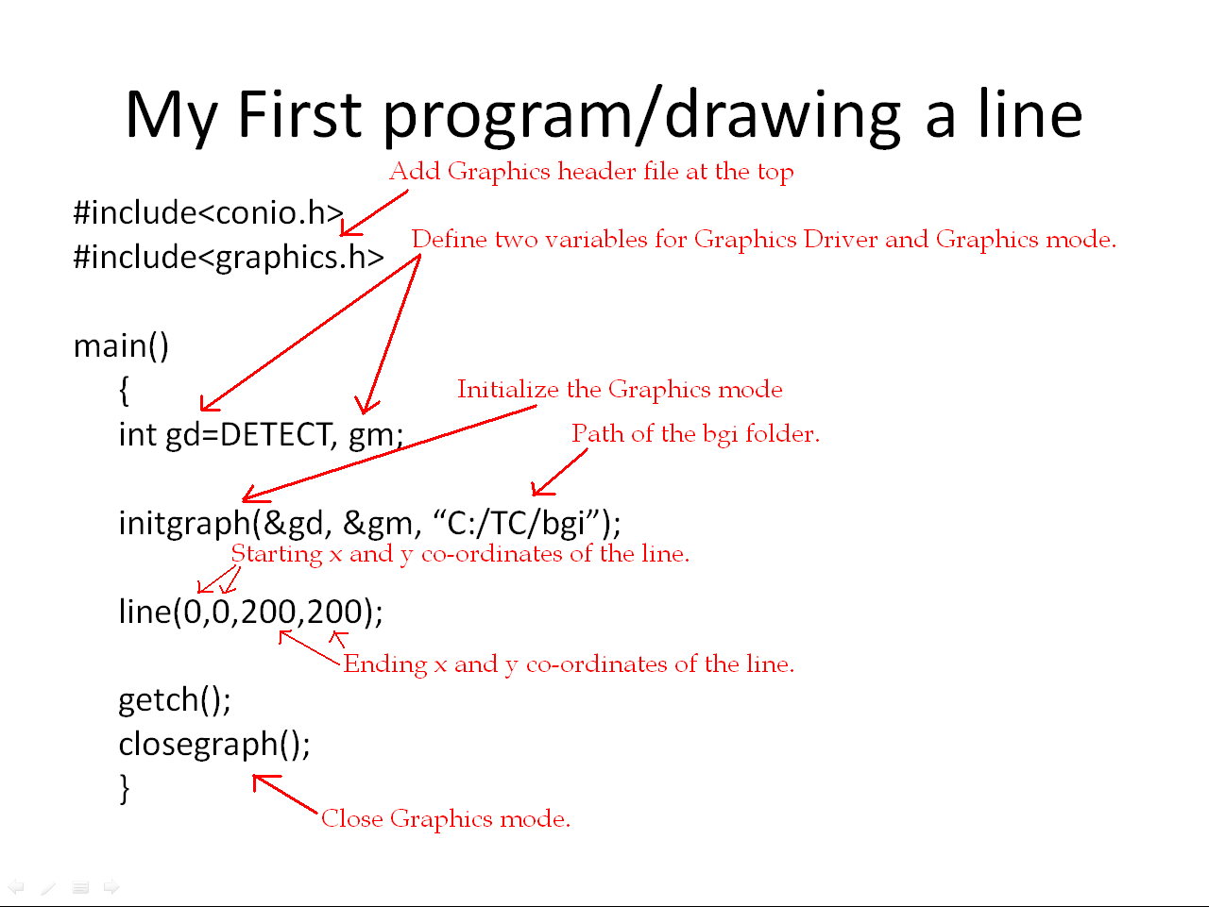
osama ahmed CT 68

Slide 5
Drawing a Circle
#include<conio.h>
#include<graphics.h>
main()
{
int gd=DETECT, gm;
initgraph(&gd, &gm, “C:/TC/bgi”);
circle(320,240,100);
getch();
closegraph();
}
osama ahmed CT 68

Slide 6
circle(320,240,100);
Explanation
A Circle takes a total of 3 arguments.
The first two arguments are used to define center of the circle in x and y co-ordinates.
Since screen has a size of 640 pixels in x-axis, so 320 is the center of x-axis.
And screen has the size of 480 pixels in y-axis, so 240 is the center of y-axis.
Third argument of the circle is its radius in pixels. In our example the radius of the circle is 100 pixels.
osama ahmed CT 68

Slide 7
Some other shapes in graphics.h library.
osama ahmed CT 68

Slide 8
arc(midx, midy,starting-angle,ending-angle,radius);
osama ahmed CT 68

Slide 9
arc(midx, midy,starting-angle,ending-angle,radius);
Explanation:
  Arc is used to draw circular arc
  Arc takes 5 arguments, all of the int type.
  First two arguments define the center of the arc to place on the screen.
  Third and Fourth arguments are starting and ending angles of the arc.
  Fifth argument is the radius of the arc in pixels.
osama ahmed CT 68

Slide 10
arc(midx, midy,starting-angle,ending-angle,radius);
arc(320,240,0,180,100);
  The above code generates an arc in the mid of the screen, angled from 0 to 180(making a half circle facing downwards), having radius of the 100 pixels.
osama ahmed CT 68

Slide 11
arc(midx, midy,starting-angle,ending-angle,radius);
arc(320,240,180,0,100);
  The above code generates an arc in the mid of the screen, angled from 0 to 180(making a half circle facing upwards), having radius of the 100 pixels.
osama ahmed CT 68

Slide 12
ractangle(left, top,right, bottom);
osama ahmed CT 68

Slide 13
ractangle(left, top,right, bottom);
Explanation:
  Rectangle is used to draw an empty rectangle.
  It takes 4 arguments all of int type.
  First two arguments are left-top corner of the rectangle, and last two arguments are right bottom corner of the rectangle.
osama ahmed CT 68

Slide 14
ractangle(left, top,right, bottom);
ractangle(100,100,200, 200);
  Output:
        (100,100)
(200,200)
osama ahmed CT 68

Slide 15
bar(left, top,right, bottom);
osama ahmed CT 68

Slide 16
bar(left, top,right, bottom);
Explanation:
  bar is used to draw a rectangle filled with given pattern.
  We use function setfillstyle(Style, Color); to give any of the style/pattern to the bar
  It takes 4 arguments all of int type.
  First two arguments are left-top corner of the rectangle, and last two arguments are right bottom corner of the rectangle.
osama ahmed CT 68

Slide 17
setfillstyle(STYLE,COLOR);
osama ahmed CT 68

Slide 18
setfillstyle(STYLE,COLOR);
Explanation:
  The setfillstyle(STYLE,COLOR); sets the fill pattern and color.
  Total of 13 styles are available to C-Compiler, which are as under:
EMPTY_FILL, SOLID_FILL, LINE_FILL, LTSLASH_FILL, SLASH_FILL, BKSLASH_FILL, LTBKSLASH_FILL, HATCH_FILL, XHATCH_FILL, INTERLEAVE_FILL, WIDE_DOT_FILL, CLOSE_DOT_FILL, USER_FILL.
We can specify the color of the object either by writing directly color name all in CAPITAL LETTERS like RED, GREEN, or by writing a corresponding equillent number of the color, like 0 for BLACK, 1 for BLUE and so on.
Similarly the fill pattern can also be replaced by their corresponding numbers, ie 0 for EMPTY_FILL, 1 for SOLID_FILL , and so on.
Hence setfillstyle(SOLID_FILL, BLUE); is equall to setfillstyle(1, 1);
Both will yield the same result.
osama ahmed CT 68

Slide 19
setfillstyle(STYLE,COLOR);
Example1:
setfillstyle(EMPTY_FILL,BLUE);
bar(20,20,100,200);
Example2:
setfillstyle(SOLID_FILL,BLUE);
bar(20,20,100,200);
osama ahmed CT 68

Slide 20
Similarly try other styles and colors and Enjoy! ☺
osama ahmed CT 68

Slide 21
ellipse(midx, midy,starting-angle,ending-angle,radius-x, radius-y);
osama ahmed CT 68

Slide 22
ellipse(midx, midy,starting-angle,ending-angle,radius-x, radius-y);
Explanation:
  Ellipse is used to draw an elliptical arc.
  Ellipse takes 6 arguments, all of the int type.
  First two arguments define the center of the ellipse to place on the screen.(ie x and y co-ordinates)
  Third and Fourth arguments are starting and ending angles of the ellipse.
  Fifth argument is the radius of the ellipse in x-axis, and sixth argument is the radius of the ellipse in y-axis.
osama ahmed CT 68

Slide 23
ellipse(midx, midy,starting-angle,ending-angle,radius-x, radius-y);
Example1:
ellipse(320,240,0,360,50,100);
osama ahmed CT 68

Slide 24
ellipse(midx, midy,starting-angle,ending-angle,radius-x, radius-y);
Example2:
ellipse(320,240,0,360,100,100);
osama ahmed CT 68

Slide 25
ellipse(midx, midy,starting-angle,ending-angle,radius-x, radius-y);
Example3:
ellipse(320,240,0,360,100,50);
osama ahmed CT 68

Slide 26
ellipse(midx, midy,starting-angle,ending-angle,radius-x, radius-y);
Example4:
ellipse(320,240,0,180,100,50);
osama ahmed CT 68

Slide 27
ellipse(midx, midy,starting-angle,ending-angle,radius-x, radius-y);
Example5:
ellipse(320,240,180,0,100,50);
osama ahmed CT 68

Slide 28
fillellipse(midx, midy,radius-x, radius-y);
osama ahmed CT 68

Slide 29
fillellipse(midx, midy,radius-x, radius-y);
Explanation:
  Fillellipse is used to draw and fill and ellipse with given style and color.
  Fillellipse takes 4 arguments, all of the int type.
  First two arguments define the center of the ellipse to place on the screen.(ie x and y co-ordinates)
  Third argument is the radius of the ellipse in x-axis, and fourth argument is the radius of the ellipse in y-axis.
osama ahmed CT 68

Slide 30
fillellipse(midx, midy,radius-x, radius-y);
Example1:
setfillstyle(EMPTY_FILL,BLUE);
Fillelipse(320,240,100,100)
Example2:
setfillstyle(SOLID_FILL,BLUE);
Bar(320,240,100,100);
osama ahmed CT 68

Slide 31
fillellipse(midx, midy,radius-x, radius-y);
Example3:
setfillstyle(EMPTY_FILL,BLUE);
Fillelipse(320,240,50,100)
Example4:
setfillstyle(SOLID_FILL,BLUE);
Bar(320,240,50,100);
osama ahmed CT 68

Slide 32
fillellipse(midx, midy,radius-x, radius-y);
Example5:
setfillstyle(EMPTY_FILL,BLUE);
Fillelipse(320,240,100,50)
Example6:
setfillstyle(SOLID_FILL,BLUE);
Bar(320,240,100,50);
osama ahmed CT 68

Slide 33
Setting font/text Style and Size settextstyle(Style, Horizontal/Vertical, Size); outtextxy(x-position, y-position, Text)
osama ahmed CT 68

Slide 34
settextstyle(Font, Direction, Size); outtextxy(x-position, y-position, Text)
Explanation:
  Settextstyle sets the Font Style, Direction and size of the Text written in outtextxy function.
  Available Font Styles in C Compiler are as under:
Font Style | Value | Meaning
DEFAULT_FONT | 0 | 8x8 bit-mapped font
TRIPLEX_FONT | 1 | Stroked triplex font
SMALL_FONT | 2 | Stroked small font
SANS_SERIF_FONT | 3 | Stroked sans-serif font
GOTHIC_FONT | 4 | Stroked gothic font
osama ahmed CT 68

Slide 35
settextstyle(Font, Direction, Size); outtextxy(x-position, y-position, Text)
  There are two available Directions for settextstyle.
Name | Value | Direction
HORIZ_DIR | 0 | Left to Right
VERT_DIR | 1 | Bottom to Top
osama ahmed CT 68

Slide 36
settextstyle(Font, Direction, Size); outtextxy(x-position, y-position, Text)
Example1:
settextstyle(DEFAULT_FONT , HORIZ_DIR,1);
outtextxy(320,240,”Hello World”);
The above code will generate an output “Hello World”, written in default font/simple font, having horizontal direction, and text size of 1.
It will be displayed in the mid of the output window.
osama ahmed CT 68

Slide 37
settextstyle(Font, Direction, Size); outtextxy(x-position, y-position, Text)
NOTE:
  You can also use number value instead of Font name and direction.
  Hence:
settextstyle(DEFAULT_FONT , HORIZ_DIR,1);
is same as:
settextstyle(0 , 0,1);
osama ahmed CT 68

